Slide 1
Village of Anmore Report to Council Bylaw No. 699-2024 – Zoning Bylaw Amendment (Pinnacle Ridge)
September 10th, 2024

Slide 2
Agenda
Purpose/Introduction
Background
Discussion
Community Amenities
Site Servicing
Site Context and Technical Studies
Proposed Zoning Amendments
Legislative Compliance
Recommended Option

Slide 3
Purpose
To provide council with an introduction to the rezoning application for the pinnacle ridge hillside development lands (pinnacle ridge)

Slide 4
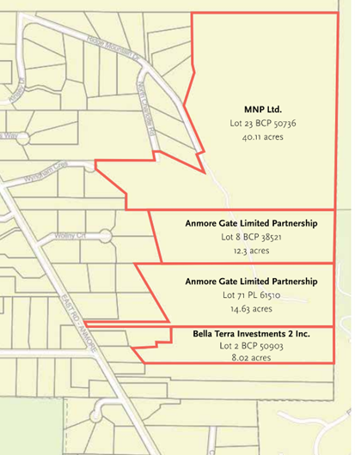
Background
June 2024:
Council determined that the pinnacle ridge OCP amendment application and proposed development was consistent with the OCP (policy RLU-8 – 1.8lots/acre for new CD zones within hillside residential)
Direction: staff to bring forward a zoning amendment bylaw for council’s consideration
July 2024:
owners of pinnacle ridge submitted a rezoning application.
Rezoning request: Amend Anmore Zoning Bylaw no. 568-2017
Current zoning: Residential 1 (RS-1)
Proposed zoning: New comprehensive development (CD) zone
Subject lands: Four parcels of Pinnacle Ridge

Slide 5
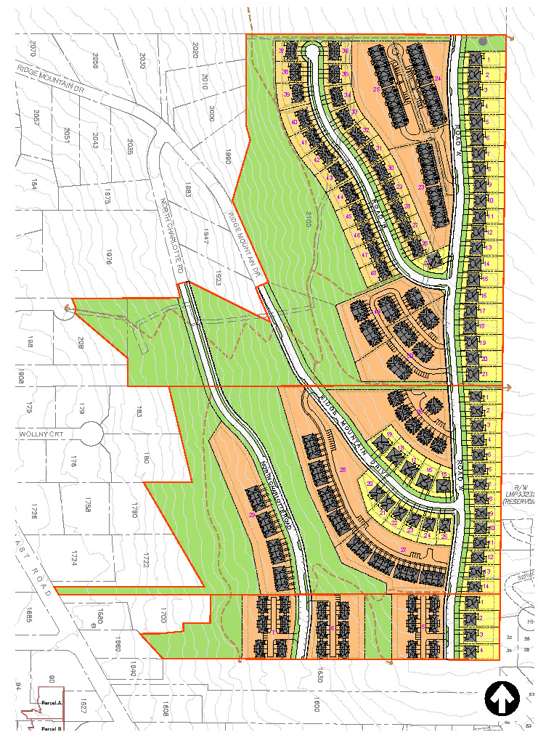
Discussion: Zoning Amendment Bylaw 699, 2024
Proposed Land Use Plan
Development proposal changes include minor alterations to site plan and an increase in total dwelling units from 261 units to 269 units
Site area: ~75 acres.
Housing Mix:
51 single-family dwelling units
46 semi-detached dwelling units
172 townhouses and stacked townhouses
Density:
1.25 lots per acre
3.6 units per acre

Slide 6
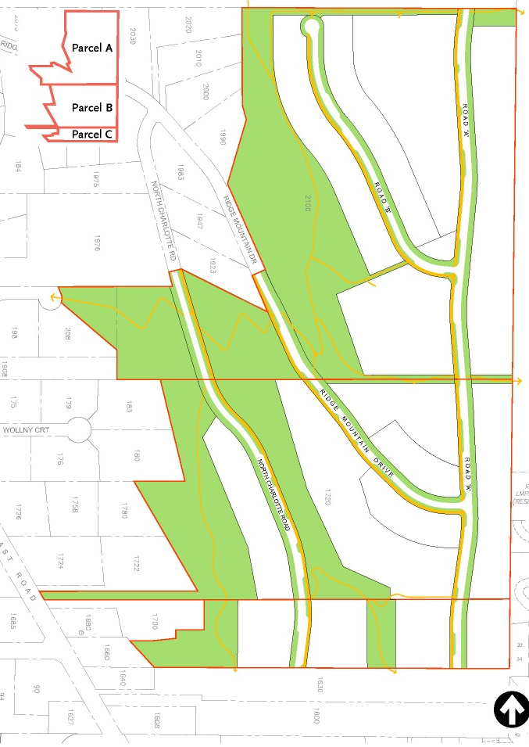
Community Amenities
Open Space and Trails
25.7 acres (34% of total site) dedicated as parkland
POLICY RLU-11 (OCP):
Provision of trails, pathways, open space or sensitive environmental areas
Exceeds 30% amenity contribution for cd zones
POLICY P&TLU-6 (OCP):
Supports primary and secondary priorities for parkland dedication:
Provision of trails and pathways
Preservation of natural habitat

Slide 7
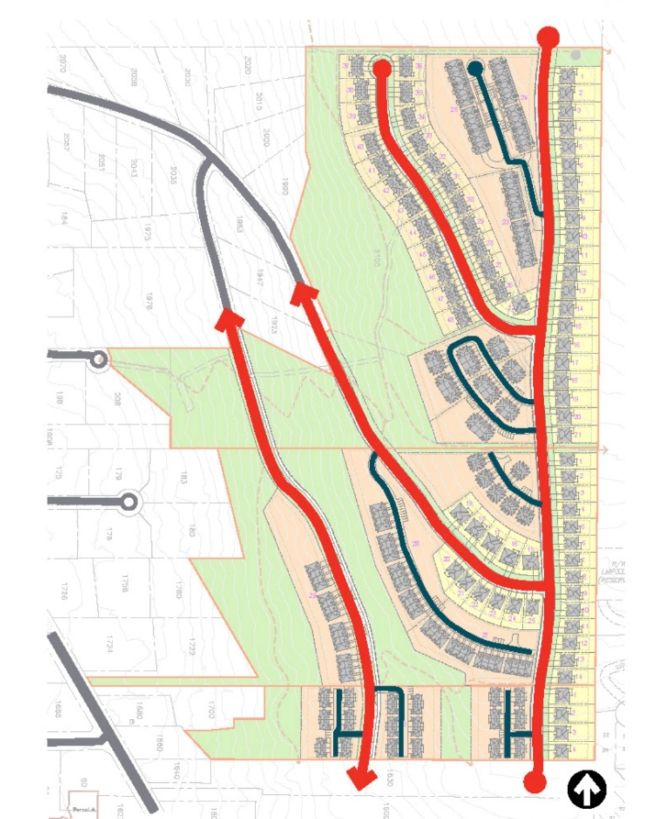
Road Dedication
OCP Policy T-16:
North charlotte road extension:
Proposed extension towards charlotte crescent to the south as a minor collector road
Ridge Mountain Drive Extension:
Extents east to new road dedications (road A and road B)
Potential extension to lands beyond to the north and south
Public Road Right-of-Way Features:
Multi-use pathways along roads
114 parallel parking spaces

Slide 8
Landscape & Architectural Guidelines
Architectural Design Principles:
Reflects Anmore’s semi-rural character
Contemporary with upscale modern, craftsman, and French country elements
Uses traditional materials, natural light, and textures that blend with the environment
Regulation:
Statutory building scheme to regulate the architectural and landscaping guidelines
Protective covenant: establish an Environmental Management Area (EMA)
Recommendation:
Applicant provide further studies relating to tree management and fuel loads to inform the implementation of Firesmart BC principles.
Notes:
A set of Architectural design principes were provided by the applicant which they believe …..

Slide 9
Provision of Amenities
Phased Development Agreement (Local Government Act s. 516):
Phased development agreement (PDA) between Village and Landowner
Sets terms for provision of amenities, and phasing and timing of development.
Terms for the registration of covenants under Land Title Act s. 219
Provides regulation assurances for both local governments and landowners.
Staff intend to consult legal counsel regarding the implication of a PDA for the Pinnacle Ridge Proposal.
Recommendation:
Land dedication finalized during subdivision stage to mitigate unknown risks, costs, and liability associated with public lands prior to subdivision approval

Slide 10
Site Servicing
Potable Water system
Design brief based off previous technical studies, village’s water utility master plan, and data from the city of port moody.
Preliminary design
Extend existing water mains along proposed road extensions from north charlotte road and ridge mountain drive .
Stubs at new road ends for future water main extensions.
Detailed system design, analysis and water modeling to be provided by the applicant as the application proceeds.
Staff review
Consideration of water system capacity and resiliency for hillside developments regarding wildfire emergency preparedness.
Staff intend to discuss alternative options with the applicant and port moody.
Recommendation:
Detailed system design, analysis and water modeling be required prior to third reading and adoption.

Slide 11
Septic Location and sizing plan
Preliminary site septic plan and location
Based on housing units, size, and potential secondary suites
Type 3 Septic Systems:
Individual systems for single-family lots
Communal systems for townhome strata lots
Further assessments needed:
Additional engineering assessments for feasibility
Consider soil suitability, topography, hydrogeological/environmental sensitivities
Assess potential groundwater, surface water impacts, and cumulative effects
Fraser health authority approves systems discharging to the ground with sewage flow < 27,000 litres/day
Recommendation:
Detailed septic design/study required for communal system for site slope development before granting third reading

Slide 12
Site Context & Technical Studies
Site overview:
Hillside development with steep slopes
Presence of watercourses and forested areas
Site plan design:
Clustered development on gentle slopes to the east
Parkland dedicated to steeper slopes
Aims to minimize disturbances to hillside and natural environment
Aligns with best practices for hillside development
Technical studies:
Preliminary studies submitted to address environmental concerns and hazards
Further studies and assessments are required

Slide 13
Overview Environmental Assessment
Environmental conditions identified:
Wildlife and wildlife habitat
Species at risk
Ecosystems and aquatic ecosystems
Regulatory considerations:
Several streams regulated under:
Water Sustainability Act
Riparian Areas Protection Regulation
Fisheries and Oceans Canada
Development implications:
Provincial approvals and development permits needed for streams and riparian areas
Possible minor site plan modifications in the northern parcel
Recommendations:
Prepare a project-specific Environmental Impact Assessment (EIA) for development phases
Build on OEA objectives & develop detailed measures and monitoring plans to mitigate environmental impacts

Slide 14
Geotechnical Assessment
Preliminary Assessment:
On all four parcels
Evaluated against terrain, hydrology, and other factors
Key Risks Identified:
Erosion and surface washouts caused by site disturbances may cause potential debris flow downslope
Mitigation Measures:
Erosion and sediment control measures
Stormwater management plan
Require Erosion and Sediment Control Permits (prior to construction, excavation, and land grading)
Slope Stability:
Feasibility confirmed with recommendations incorporated into overall design
Additional design and grading plan reviews be conducted by a Qualified Professional
Staff Recommendations:
Place a covenant (Local Government Act s. 219) on title to ensure adherence to ongoing and updated geotechnical recommendations and measures

Slide 15
Hydrogeological Investigation Report
Key Findings:
Geological & Subsurface Conditions:
Detailed description of soil and hydrogeological conditions
Seepage Analysis:
Estimated no significant groundwater seepage (pooling) into excavation sites
Groundwater Impact Assessment:
Low risk of groundwater subsidence (subduction/sinking)
No impacts to nearby water wells
No significant impacts from Mossum Creek (west) and West Noons Creek (east)
No impacts from surface water drainage features
Recommendations:
Groundwater management plan with proposed measures included in Erosion and Sediment Control Plan
Address seepage and precipitation during construction
Address seepage and runoff post-construction for basements
Measures for the proposed development to be reflected in a covenant on title (LGA s.219)

Slide 16
Stormwater Strategy
Technical studies
Preliminary Storm Sewer Layout
Detailed design and calculations will be required
Recommendations:
S. 219 Covenants be placed on title for the construction, repair, maintenance and replacement of an appropriate storm water system as defined through further design and assessments.
Include design recommendations outlined in the geotechnical site assessment
Tree Inventory and Assessment Report
Recommendations
Tree Inventory and Assessment Report prior to third reading
Hazard trees identified and removed prior to land dedications
Tree Retention Plan and restrictive covenant be placed on title prior to subdivision approval

Slide 17
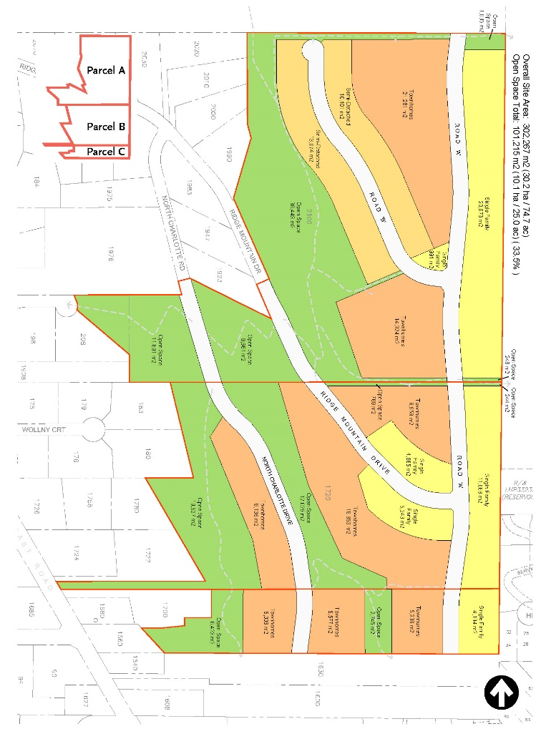
Part 9 - Proposed Zoning Bylaw CD-8
Permitted uses and minimum parcel size:
Bill 44 Considerations
Does not apply to private covenants
Statutory Building scheme to prohibit secondary suites in Two Family Dwelling and Townhouses

Slide 18
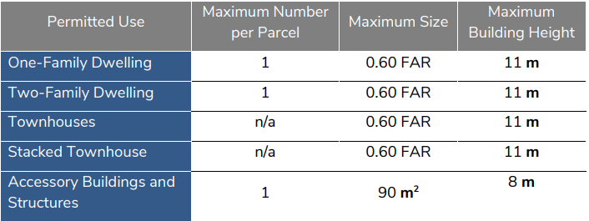
Site Coverage
45% parcel coverage for one-family and two-family dwellings
60% parcel coverage for townhouses
Small lot sizes are required for clustered development.
Inclusion of secondary suites in the one-family dwelling units would necessitate a higher FAR and site coverage.
Building Setbacks, Size and Height
Floor Area Ratio (FAR) & Height
Setbacks

Slide 19
Off-street parking
0.2 visitor stalls per townhome
1 disabled persons parking or 1% of the total required parking for a strata lot (whichever is greater)
Aisle, access and maneuvering standards
Private and shared amenity area standards
design, location, size, maintenance for strata parcels
Landscaping
Subject to existing landscaping bylaws
requirements for front yard and overall site landscaping standards
WATSE COLLECTION
Strata parcel waste collection standards
Access and maneuvering requirements

Slide 20
Part 2 - Definitions
Townhouse a building containing 2 or more attached principal dwelling units characterised by individual ownership each having separate ground-oriented access.
Stacked Townhouses means townhouses, except that two principal dwelling(s) are arranged vertically so that dwelling(s) may be placed wholly or partially over the other dwelling. Each principal dwelling will have an individual access to outside, not necessarily at finished grade, provided that no more than two units share a corridor, steps, or path.
Attached means a building or structure physically connected by a common wall at least 3m in length providing internal connections to all enclosed spaces within all buildings or structures. For the purposes of this definition, buildings or structures connected solely by a roof will not be considered attached.
Strata Parcel means a strata parcel as defined by the Strata Property Act;

Slide 21
Legislated Requirements
Notice of Council’s consideration of Bylaw 699-2024 was given prior to first reading in accordance with section 467 of the LGA.
**All legislated requirements have been met and Council may grant first reading of the proposed Amendment Bylaw.

Slide 22
Public Engagement
Public Engagement plan
Recommended given the scale of the proposed development
Informal process and may include open houses, workshops etc.
Provide council with insights to community needs
Inform residents of the proposed development

Slide 23
Recommended Option
1. THAT Anmore Zoning amendment Bylaw no. 699-2024, be given first reading; and,
THAT Anmore Zoning Amendment Bylaw no. 699-2024 and the development proposal be referred to the Advisory Planning Commission and Committee of the Whole with the following items for discussion: community amenity contributions, public engagement strategy, financial sustainability and other topics staff believe to be important for community discussion; and,
THAT staff bring forward a Community Engagement Plan in relation to the rezoning of Pinnacle Ridge Hillside Development.

Slide 24
Questions?

